Slide 1

Essentials of Electronics Design
From Ohm's Law to EasyEDA
Comprehensive Curriculum

Slide 2
Electronic Components
Passive Components:
Components that do not require an external power source to operate. They primarily modify or control the flow of electrical signals without amplification. Examples include resistors, capacitors, inductors, and transformers.
Electronic Components
Passive Components
Active Components
Active Components:
Components that require an external power source to operate. They can amplify, rectify, or switch electrical signals. Examples include transistors, diodes, operational amplifiers (op-amps), and integrated circuits (ICs).

Slide 3
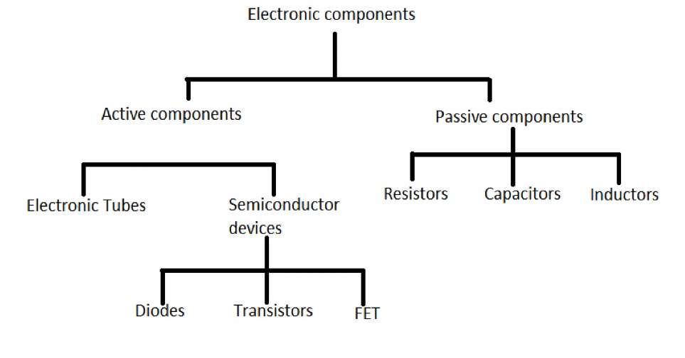
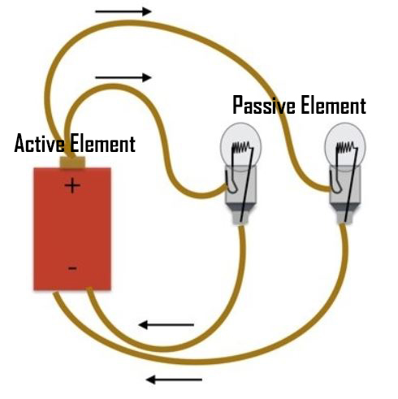
Classification of Electronic Components

Slide 4


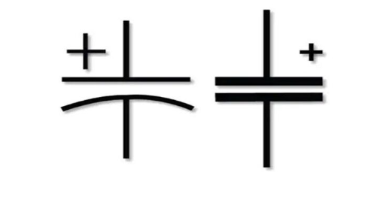
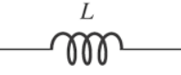

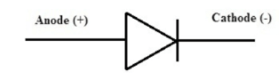
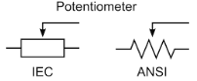
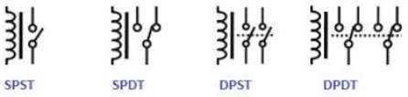
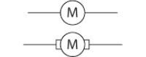
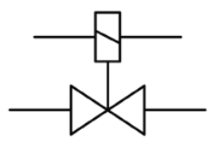
Table of Passive Components
Passive Components | S.I Unit | Symbol
Resistors | Ohm
Capacitors | farad
Inductors | henry
Transformers | kilovolt-amperes
Diodes | -
Potentiometer | volt/metre
Relays | -
Motors | -
Solenoid | -

Slide 5
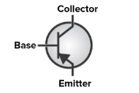
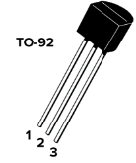
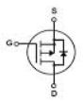

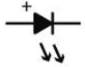
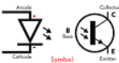
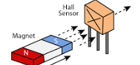
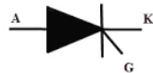
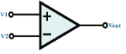
Table of Active Components
Active Components | Relationship/Unit | Symbols
Transistors | Ampere (A), Volt (V), and Ohm (Ω), respectively.
MOSFETS | Ampere per Volt
Crystal Oscillator | Hertz
Leds | Candela
Opto Couplers | Volts
Hall effect sensors | tesla (T)
Silicon-controlled rectifiers | Volt/Ampere
Comparators | Voltage (V)

Slide 6
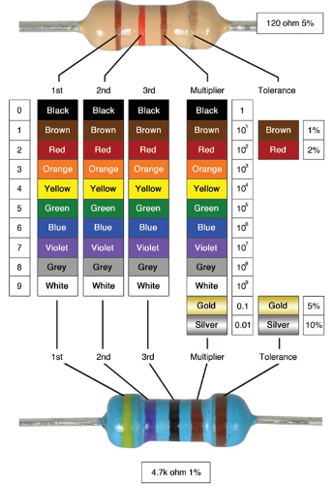
Passive Components:
Resistors :
Resistors are passive electrical components that resist the flow of electrical current. They are commonly used to limit current, divide voltage, adjust signal levels, terminate transmission lines, and provide biasing in electronic circuits.
Applications:
Voltage division: Used in voltage dividers to produce a fraction of an input voltage.
Current limiting: Protecting components by limiting current flow.
Biasing: Setting the operating point of active components like transistors.
Signal conditioning: Shaping or scaling signals in electronic circuits.

Slide 7
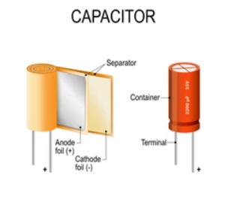
Passive Components:
Capacitors:
Capacitors store electrical energy in an electric field. They consist of two conductive plates separated by an insulating material (dielectric).
Applications:
Energy storage: Capacitors store energy in circuits and release it when needed.
Filtering: Smoothing out voltage variations and filtering noise.
Timing: Used in combination with resistors to create timing circuits.
Coupling: Transmitting AC signals while blocking DC.

Slide 8
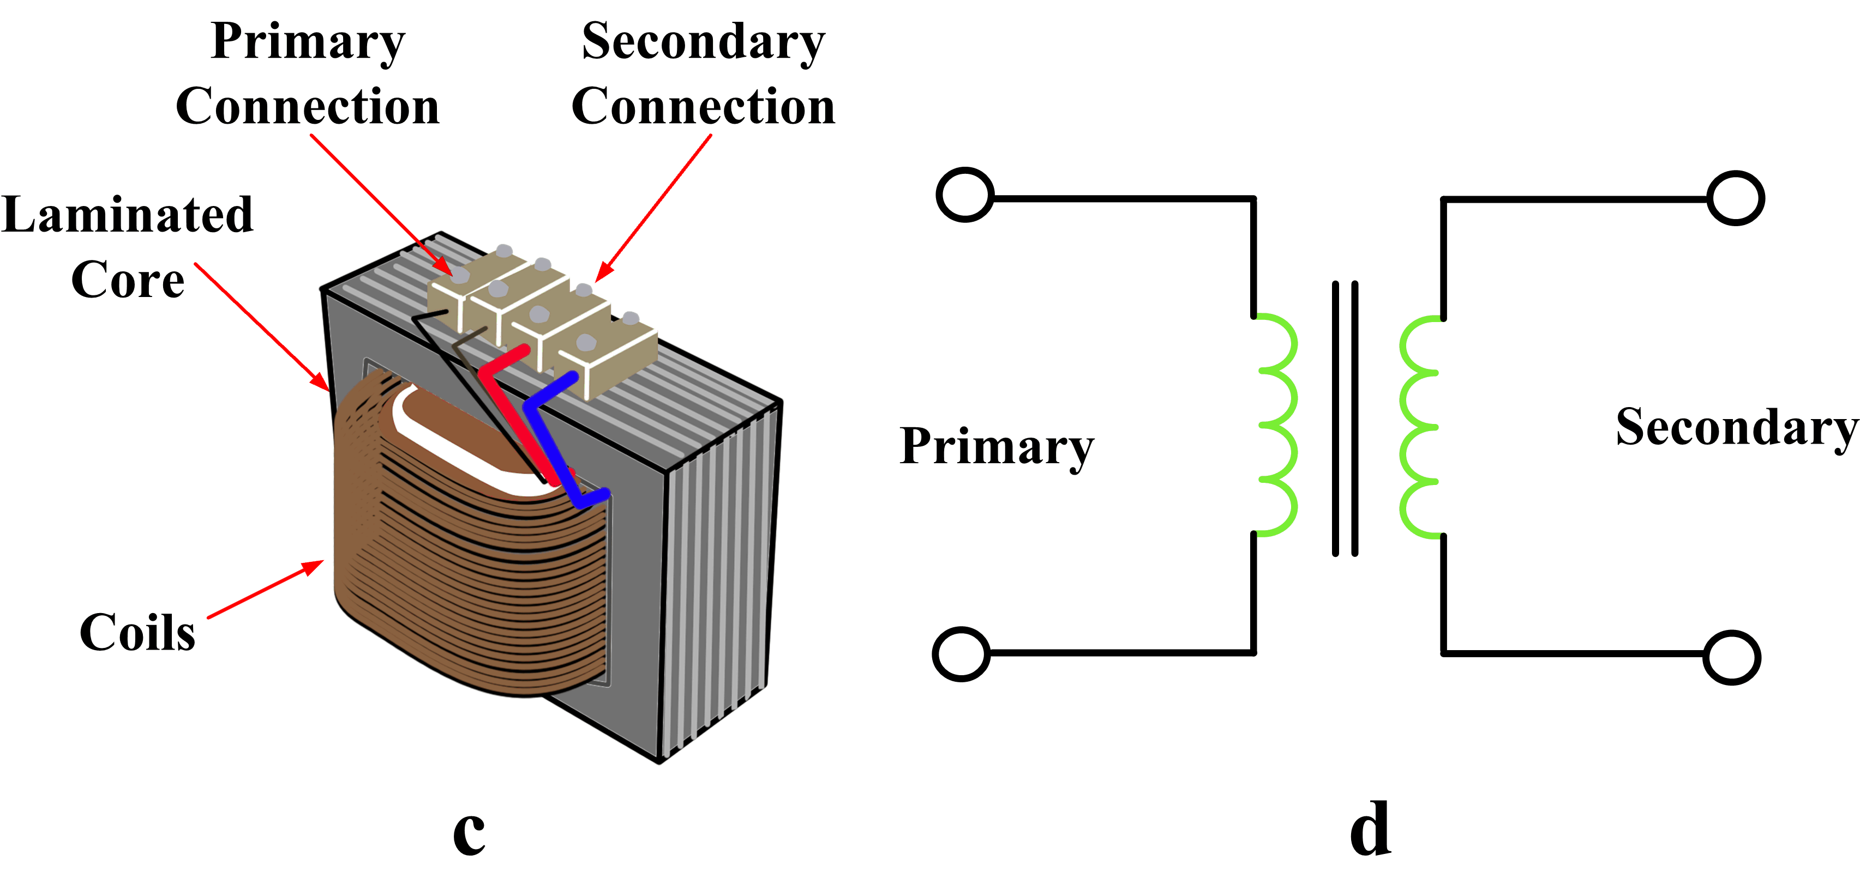
Passive Components:
Inductors:
Inductors are passive electrical components that store energy in a magnetic field when current flows through them. They consist of a coil of wire wound around a core material.
Applications:
Filtering: Blocking certain frequencies while allowing others to pass.
Energy storage: Inductors store energy in magnetic fields and release it when needed.
Inductive coupling: Transferring energy between circuits without direct electrical connection.
Signal processing: Used in oscillators, filters, and impedance matching circuits.

Slide 9
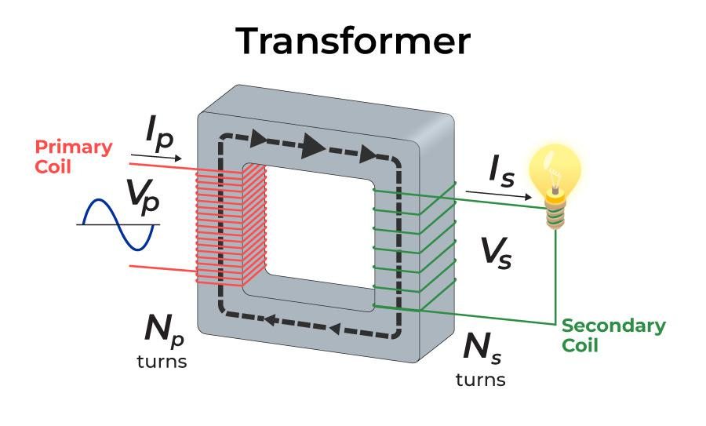
Passive Components
Transformers:
Transformers are passive devices that transfer electrical energy between two or more circuits through electromagnetic induction. They consist of two or more coils of wire wrapped around a magnetic core.
Applications:
Voltage transformation: Changing the voltage level between circuits (step-up or step-down).
Isolation: Electrically isolating circuits while transferring power.
Impedance matching: Matching the impedance between input and output circuits.
AC power distribution: Transmitting electricity efficiently over long distances.

Slide 10
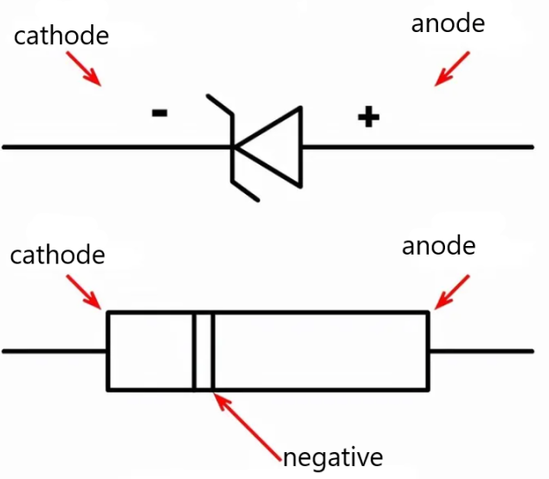
Passive Components
Diodes:
Diodes are semiconductor devices that allow current to flow in one direction only. They consist of a PN junction.
Applications:
Rectification: Converting AC to DC by allowing current flow in only one direction.
Voltage regulation: Stabilizing voltage levels in circuits.
Signal demodulation: Recovering the original signal from modulated signals.
Protection: Preventing reverse current flow and voltage spikes in circuits.

Slide 11
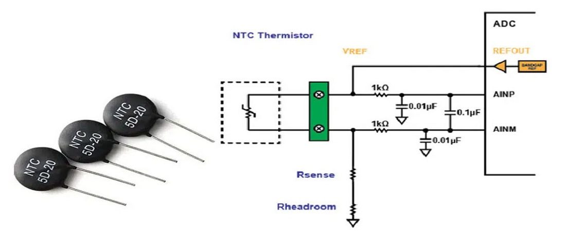
Passive Components
Thermistors:
Thermistors are temperature-sensitive resistors whose resistance changes significantly with temperature.
Applications:
Temperature measurement: Used in thermostats, temperature sensors, and thermal protection circuits.
Compensation: Providing compensation for temperature-dependent effects in circuits.
Control: Regulating temperature in heating and cooling systems.
Current limiting: Protecting circuits from excessive current flow by using their temperature-dependent resistance.

Slide 12
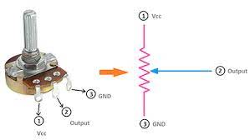
Passive Components
Potentiometers:
Potentiometers, or variable resistors, are resistors with an adjustable tapping point. By adjusting the tapping point, the resistance between the two endpoints can be varied.
Applications:
Voltage division: Adjusting voltage levels in circuits.
Volume control: Adjusting the volume in audio equipment.
Biasing: Setting the operating point in electronic circuits.
Tuning: Adjusting the frequency in radio circuits.

Slide 13
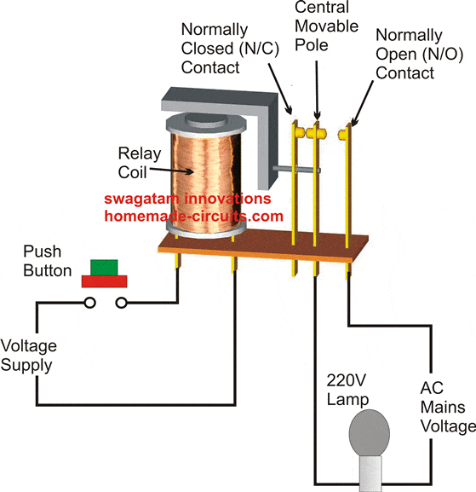
Passive Component
Relays:
Relays are electromagnetic switches, they use an electromagnet to mechanically operate a switch.
Applications:
Switching high-power circuits: Controlling motors, lights, and heaters.
Signal routing: Selecting between multiple inputs or outputs in electronic systems.
Circuit protection: Disconnecting circuits in case of overload or fault conditions.

Slide 14
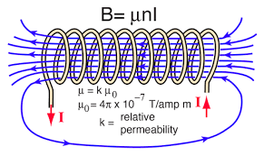
Passive Component
Solenoids:
Solenoids are devices that convert electrical energy into linear motion using an electromagnetic coil.
Applications:
Actuation: Opening and closing valves, doors, and latches.
Control systems: Controlling the position of mechanical components in automotive systems, industrial machinery, and consumer electronics.

Slide 15
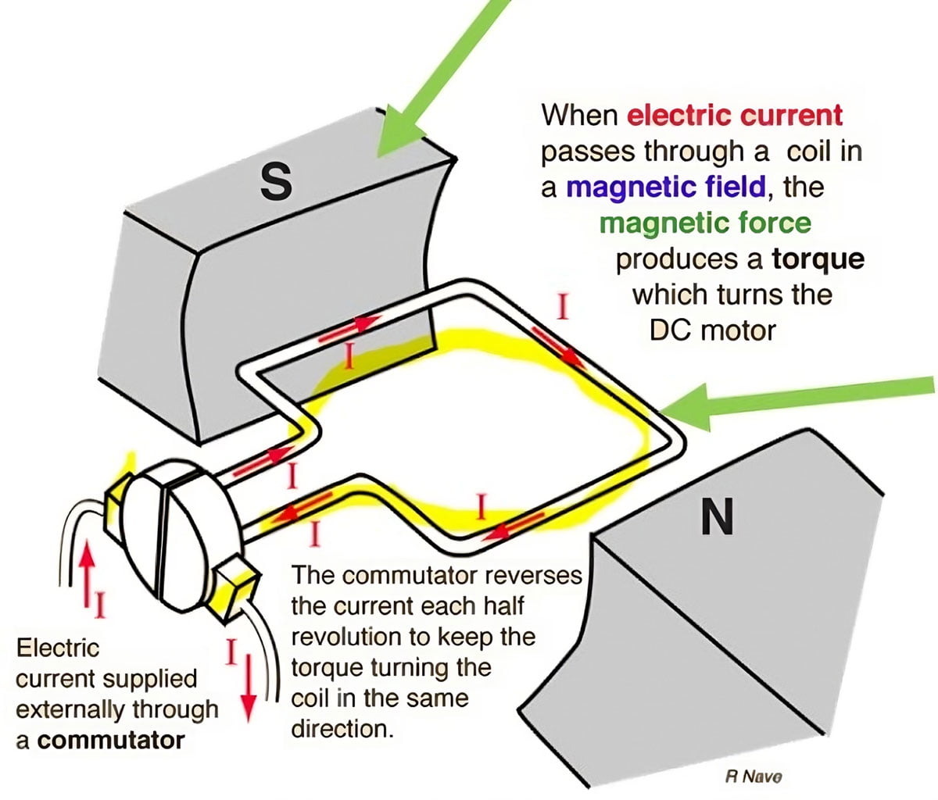
Passive Components
Motors:
Motors are devices that convert electrical energy into mechanical motion.
Applications:
Motion control: Driving machinery, appliances, and vehicles.
Actuation: Moving mechanical components in robotics, automation, and industrial systems.
Energy conversion: Converting electrical energy into rotational or linear motion in generators and actuators.

Slide 16
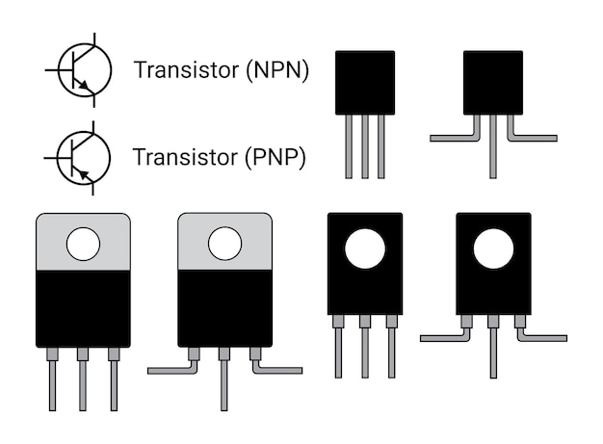
Active Components
Transistor:
A transistor is a semiconductor device used to amplify or switch electronic signals and electrical power. It comes in various types such as bipolar junction transistors (BJTs) and field-effect transistors (FETs).
Applications
Amplification: "Transistors amplify weak signals, crucial for applications like audio amplifiers and radio frequency circuits."
Switching: "Transistors act as electronic switches, controlling current flow in digital circuits for devices like microcontrollers and power switches."
Voltage Regulation: "They are integral to voltage regulation circuits, ensuring stable output voltages despite varying input or load conditions."
Signal Modulation: "Used for encoding information onto carrier signals, facilitating communication systems like radio transmission."

Slide 17
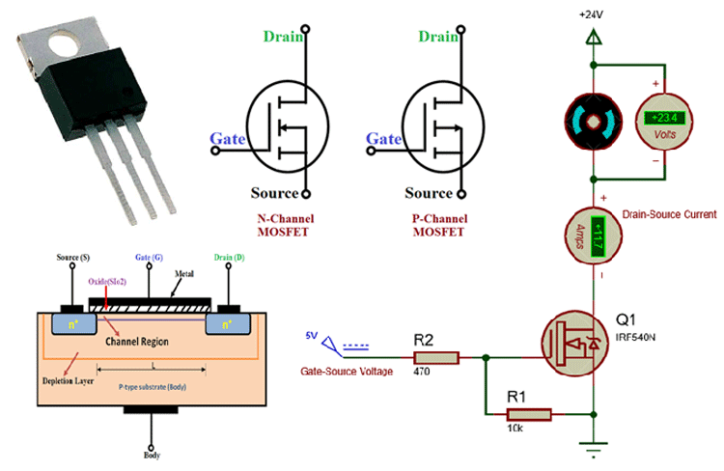
Active Components
MOSFET
MOSFET is a type of field-effect transistor where the flow of charge carriers (electrons or holes) is controlled by an electric field.
Applications
Power Amplification: "MOSFETs amplify power in applications such as audio amplifiers and motor control."
Switching: "They swiftly control the flow of power in electronic switches for efficient operation in DC-DC converters and LED drivers."
Analog Signal Processing: "MOSFETs process analog signals for tasks like voltage amplification and filtering in electronic circuits."
Memory: "Essential components in non-volatile memory technologies like Flash memory and EEPROM."
Voltage Regulation: "Utilized in voltage regulator circuits for precise voltage regulation in portable devices and power supplies."

Slide 18
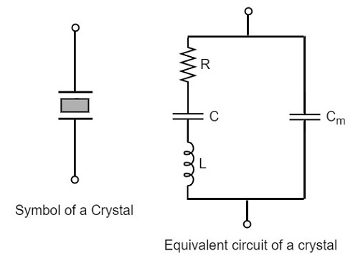
Active Components
Crystal Oscillator
A crystal oscillator is an electronic oscillator circuit that uses the mechanical resonance of a vibrating crystal of piezoelectric material to create an electrical signal with a precise frequency.
Applications
Clock Generation: "Crystal oscillators produce accurate clock signals, vital for synchronization in digital circuits."
Frequency Synthesis: "They synthesize stable output frequencies for applications like radio transmitters and wireless communication systems."
Signal Conditioning: "Used in signal conditioning circuits to generate stable reference frequencies for precision measurement instruments."
Timing Applications: "Applied in various timing applications, including event timing and timekeeping in digital systems."

Slide 19
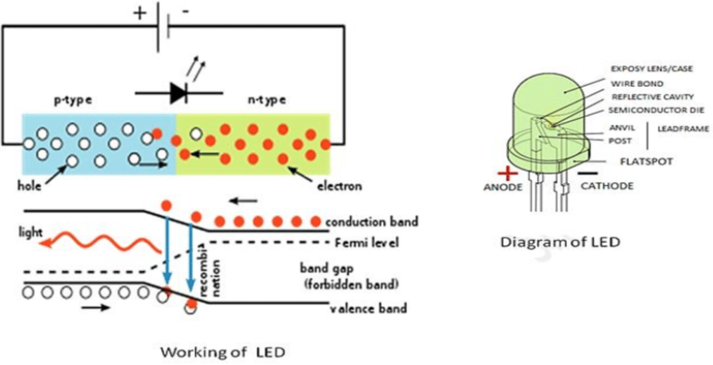
Active Components
LEDs (Light-Emitting Diodes):
LEDs are semiconductor light sources that emit light when an electric current passes through them. They are often used as indicators, illuminators, and in displays.
Applications
Lighting: "LEDs are energy-efficient light sources widely used in both residential and commercial lighting applications."
Indicator Lights: "LEDs provide visual indication for device status in electronics, from power on/off to system alerts."
Automotive Lighting: "They illuminate headlights, taillights, and interior lighting in vehicles, offering durability and efficiency."
Backlighting: "LEDs backlight LCD panels in electronic displays like smartphones and TVs, ensuring vibrant visuals."

Slide 20
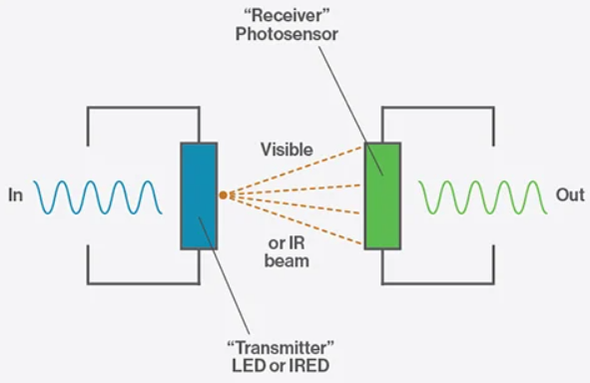
Active Component
Optocoupler:
An optocoupler, also known as an opto-isolator, is a device that transfers electrical signals between two isolated circuits using light waves, typically emitted by an LED and detected by a photosensitive transistor or diode.
Application
Isolation: "Optocouplers provide electrical isolation between circuits, critical for preventing ground loops and ensuring safety."
Signal Transmission: "They transmit analog or digital signals between circuits, particularly useful in noisy environments or high-voltage systems."
Feedback Circuits: "Used in feedback loops to isolate the feedback path, ensuring stability and performance in power supplies and amplifiers."
Motor Control: "Applied in motor control circuits to provide isolation between control signals and power electronics, minimizing electrical noise."

Slide 21
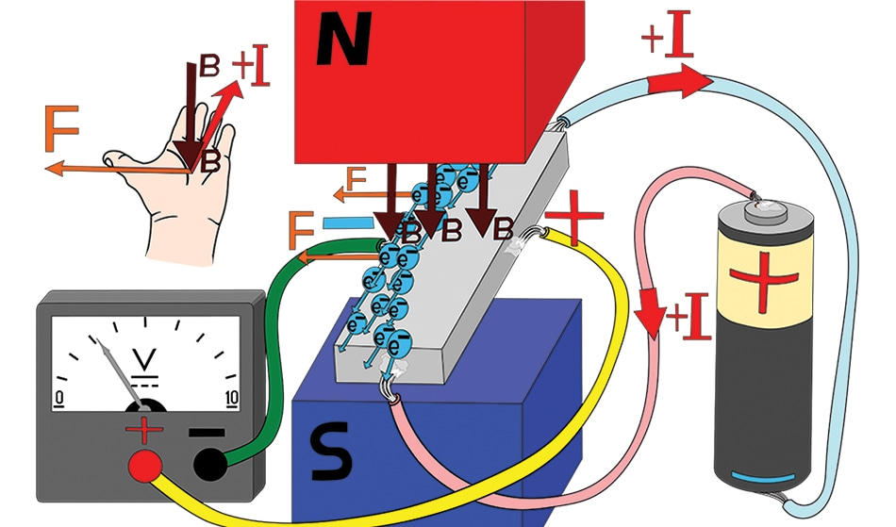
Active Component
Hall Effect Sensor:
A Hall effect sensor is a transducer that varies its output voltage in response to changes in magnetic field strength. It operates based on the Hall effect phenomenon.
Applications
Position and Proximity Sensing: "Hall effect sensors detect nearby magnetic objects, enabling applications like rotary encoders and proximity sensors."
Current Sensing: "They measure magnetic fields generated by current flow, providing non-invasive current sensing in motor control and power monitoring."
Brushless DC Motor Control: "Used with permanent magnets for feedback in brushless DC motors, allowing precise speed and direction control."
Speed Measurement: "Hall effect sensors measure rotational speed in gears and wheels, vital for automotive speedometers and industrial machinery."

Slide 22
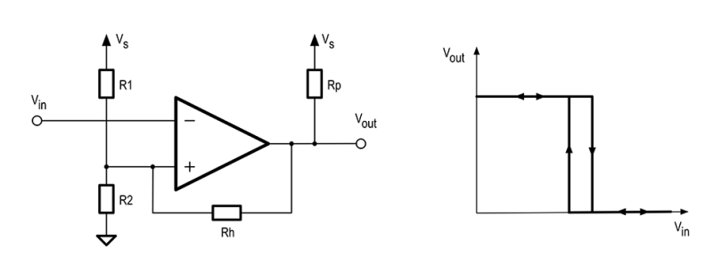
Active Component
Comparator:
A comparator is an electronic circuit that compares two voltage inputs and produces an output based on their relative magnitudes.
Applications
Voltage Level Detection: "Comparators detect voltage levels against references, crucial for threshold detection and voltage monitoring."
Window Detection: "They trigger events based on voltage within predefined ranges, used in temperature control and alarm systems."
Zero Crossing Detection: "Comparators detect zero-crossing points in AC signals, vital for synchronization and phase control in power electronics."
Pulse Width Modulation (PWM): "Used in PWM circuits to generate variable-width pulses based on comparison, applied in motor control and power supplies."

Slide 23

Snubber Circuits

Slide 24
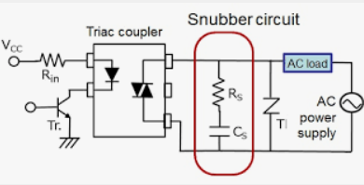
What is a Snubber Circuit?
A snubber circuit is like a bodyguard for electronic devices, especially diodes. It's made of a resistor and a capacitor, which are connected together and placed near the device they're protecting. Their job is to absorb any sudden spikes in voltage that can happen when the device switches on or off. These spikes can damage the device, but the snubber circuit absorbs them, keeping everything safe.

Slide 25
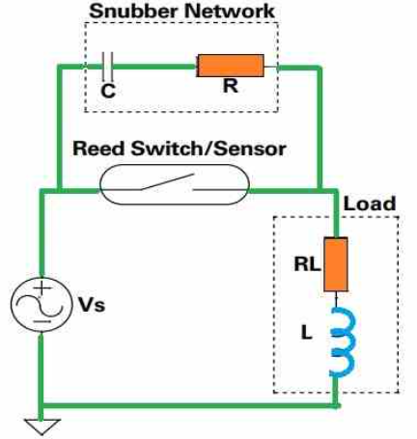
How Does it Work?
Imagine you have a water hose and you suddenly turn off the tap. The water in the hose keeps moving and can cause a big splash at the end. The resistor in the snubber circuit acts like a valve, slowing down this "splash" of electricity. The capacitor is like a sponge, soaking up the extra energy from the splash.

Slide 26
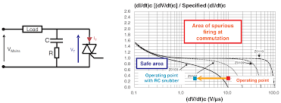
Advantages:
Keeps devices safe from voltage spikes.
Reduces the risk of things breaking unexpectedly.
Lessens annoying electromagnetic interference.
Helps regulate voltage in power supplies.
Stops devices from making unwanted noise.

Slide 27
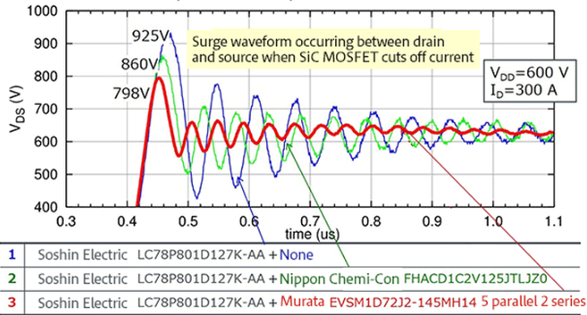
Disadvantages:
Adds some complexity and cost to the circuit.
Might not work perfectly in all situations.
Can cause some extra energy loss.
Choosing the right size of components can be tricky.
Works better in some situations than others.

Slide 28
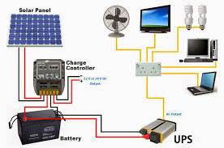
Applications:
Protecting motors from damage in machines.
Keeping audio systems stable and quiet.
Safeguarding solar power systems from sunlight changes.
Ensuring UPS systems switch smoothly.
Helping power converters work well, like in chargers.

Slide 29
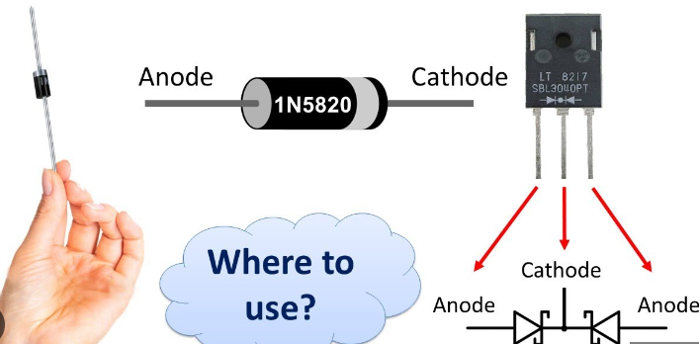
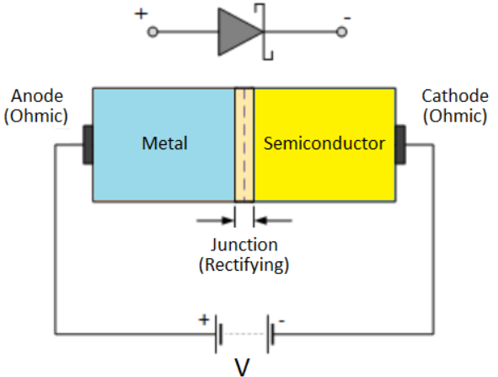
Detailed Explanation On Diodes

Slide 30
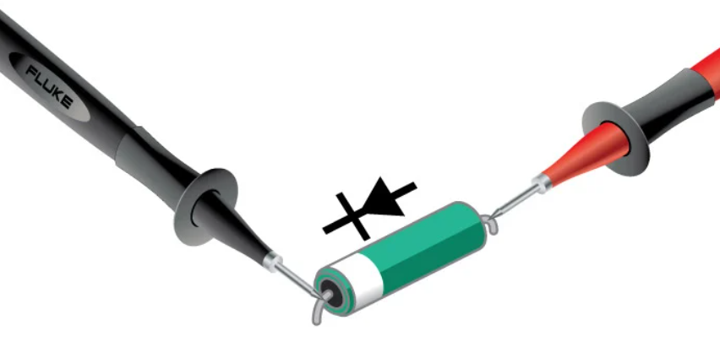
What is Diode ?
A diode is a semiconductor device that essentially acts as a one-way switch for current. It allows current to flow easily in one direction, but severely restricts current from flowing in the opposite direction.
Diodes are also known as rectifiers because they change alternating current (ac) into pulsating direct current (dc). Diodes are rated according to their type, voltage, and current capacity.
Diodes have polarity, determined by an anode (positive lead) and cathode (negative lead). Most diodes allow current to flow only when positive voltage is applied to the anode.

Slide 31
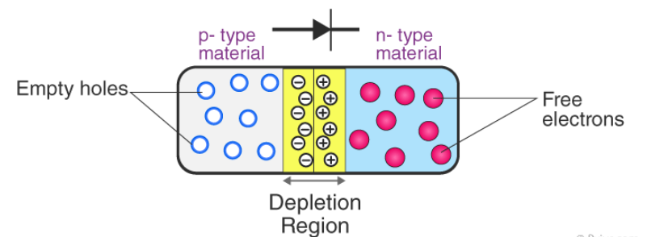
Formation of P-N Junction
To create a P-N junction, we start with a thin p-type silicon semiconductor sheet and introduce a small amount of pentavalent impurity, transforming part of the material into n-type silicon. This process establishes both p-type and n-type regions within the sheet, delineated by the junction between them. Subsequently, two fundamental processes ensue: diffusion and drift. During diffusion, holes from the p-side and electrons from the n-side migrate across the junction, driven by disparities in their concentrations, thereby generating a diffusion current. As this occurs, an accumulation of ionized donors on the n-side and acceptors on the p-side gives rise to a depletion region. In this region, a layer of positive charge forms on the n-side, while a negative charge layer forms on the p-side, establishing an electric field. This electric field induces drift, whereby electrons move from the p-side to the n-side against the diffusion current, maintaining equilibrium within the junction.

Slide 32
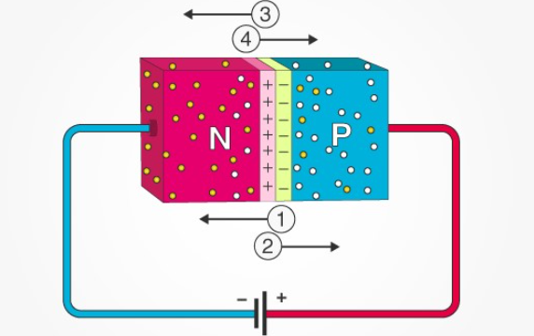
Forward Bias
When the p-type is connected to the battery’s positive terminal and the n-type to the negative terminal, then the P-N junction is said to be forward-biased. When the P-N junction is forward biased, the built-in electric field at the P-N junction and the applied electric field are in opposite directions. When both the electric fields add up, the resultant electric field has a magnitude lesser than the built-in electric field. This results in a less resistive and thinner depletion region. The depletion region’s resistance becomes negligible when the applied voltage is large. In silicon, at the voltage of 0.6 V, the resistance of the depletion region becomes completely negligible, and the current flows across it unimpeded.

Slide 33
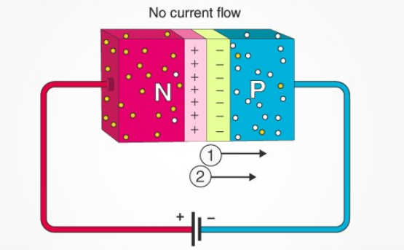
Reverse Bias
When the p-type is connected to the battery’s negative terminal and the n-type is connected to the positive side, the P-N junction is reverse biased. In this case, the built-in electric field and the applied electric field are in the same direction. When the two fields are added, the resultant electric field is in the same direction as the built-in electric field, creating a more resistive, thicker depletion region. The depletion region becomes more resistive and thicker if the applied voltage becomes larger.

Slide 34
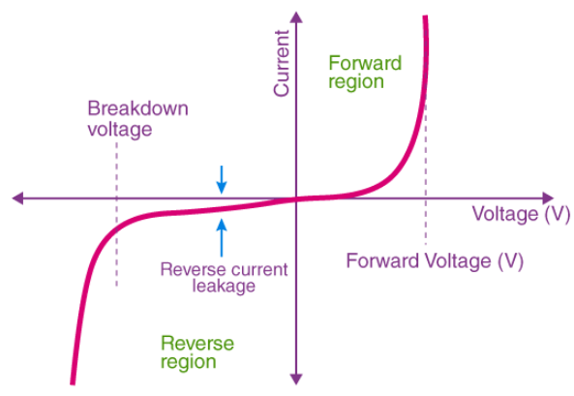
V-I Characteristics of P-N Junction Diode:
The V-I characteristics of a P-N junction diode depict its behavior concerning voltage and current. It is represented as a curve with voltage on the x-axis and current on the y-axis. The curve delineates three operating regions:
Zero Bias: In this state, no external voltage is applied, and the potential barrier at the junction prevents current flow.
Forward Bias: When the diode is forward biased, the p-type terminal connects to the positive voltage, reducing the potential barrier. For silicon diodes, this occurs at around 0.7 V, and for germanium diodes, at approximately 0.3 V, enabling current flow.
Reverse Bias: Here, the p-type terminal connects to the negative voltage, increasing the potential barrier, hindering current flow. Initially, a reverse saturation current flows due to minority carriers present in the junction.
During forward bias, the current gradually increases, initially non-linearly as the voltage overcomes the barrier, then sharply linearly. In reverse bias, the potential barrier increases, and excessive voltage may lead to breakdown, potentially damaging the diode.

Slide 35
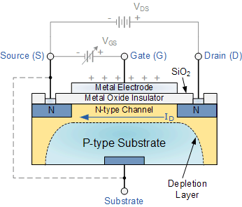
Metal-Oxide-Semiconductor Field-Effect Transistors)
MOSFETs are semiconductor devices with three terminals: source, drain, and gate. They function as voltage-controlled switches or amplifiers and are crucial components in electronic circuits. MOSFETs come in depletion-type or enhancement-type, and can be p-channel or n-channel, depending on charge carrier type. Despite structural differences, all MOSFETs modulate an electric field within the semiconductor to control current flow between the terminals.
Regions Of MOSFETS:
Cut-Off Region: The MOSFET is off with no current flow, acting as an open switch suitable for electronic switching applications.
Ohmic or Linear Region: In this region, the MOSFET operates as an amplifier, with current (IDS) increasing linearly with voltage (VDS).
Saturation Region: MOSFETs maintain constant IDS despite increasing VDS, behaving like a closed switch after reaching pinch-off voltage (VP). Used for switching operations requiring saturated current flow.

Slide 36
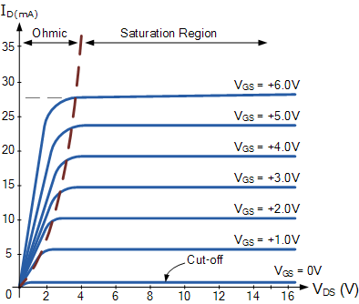
Operating regions of MOSFET

Slide 37
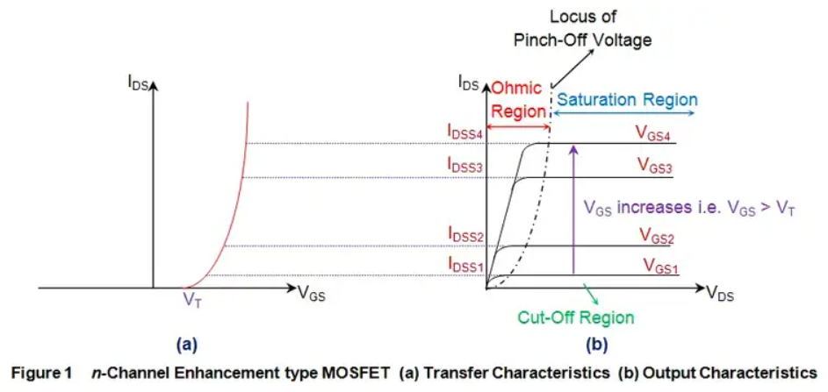
n-channel Enhancement-type MOSFET
For n-channel Enhancement-type MOSFETs, the biasing conditions determine the operational regions experienced. Figure 1a illustrates the transfer characteristics (IDS vs. VGS), showing that current flow begins only when VGS exceeds the threshold voltage (VT). Below this threshold, no channel exists between drain and source, resulting in zero current flow—a state known as the cut-off region. Even with an increase in VDS, no current flows, as shown in Figure 1b.
Once VGS surpasses VT, current starts to flow, initially increasing linearly with IDS in the Ohmic region, then saturating as determined by VGS in the saturation region. Increasing VGS leads to higher saturation current, as depicted in Figure 1b, where IDSS2 exceeds IDSS1 when VGS2 > VGS1, and so on. The locus of pinch-off voltage (VP), indicated by the discontinuous curve in Figure 1b, shifts upward with increasing VGS.

Slide 38
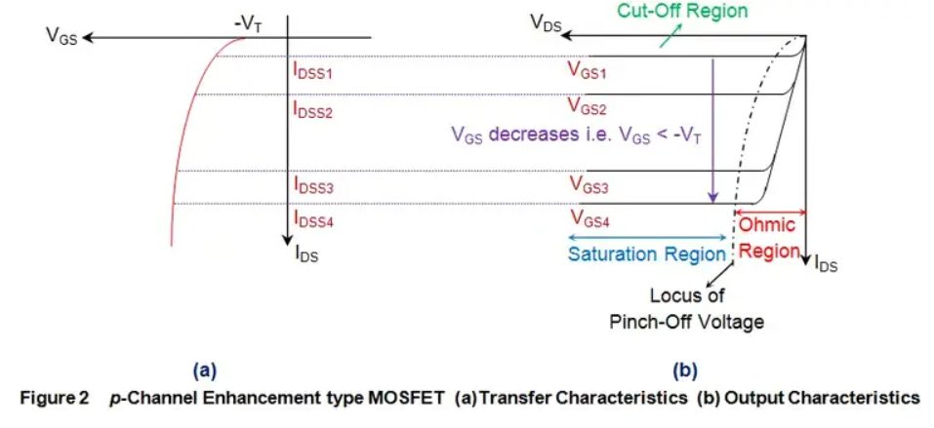
P-channel Enhancement-type MOSFET
Figure 2a displays the transfer characteristics of p-type enhancement MOSFETs, revealing that IDS remains zero until VGS equals -VT, signifying the cutoff state. Only then does a channel form between drain and source terminals, allowing current flow. Subsequently, IDS increases in the reverse direction as VDS decreases, indicating operation in the ohmic region, where current rises with applied voltage (VSD).
As VDS reaches -VP, the device enters saturation, characterized by a saturated current (IDSS) flowing through it, determined by VGS. Notably, the saturation current increases with more negative VGS values, with IDSS for VGS3 surpassing that for VGS2 and significantly exceeding both for VGS4, reflecting their increasing negativity. Additionally, the locus of the pinch-off voltage shows that as VGS becomes more negative, VP also increases in negativity.

Slide 39

n-channel Depletion-type MOSFET
The transfer characteristics of n-channel Depletion-type MOSFETs depicted in Figure 3a reveal that the device conducts current even with VGS at 0V. This indicates that these MOSFETs can conduct even without biasing the gate terminal, as evidenced by the VGS0 curve.
Under this unbiased condition, the current through the MOSFET increases with rising VDS, representing the Ohmic region, until VDS reaches the pinch-off voltage VP. Beyond this point, IDS saturates to a specific level, IDSS, in the saturation region, which increases with higher VGS values—illustrated by IDSS3 > IDSS2 > IDSS1 as VGS3 > VGS2 > VGS1.
Moreover, the locus of the pinch-off voltage demonstrates that VP increases with increasing VGS. However, to operate these devices in a cut-off state, a negative VGS is required. Once VGS becomes equal to -VT, conduction through the device ceases (IDS = 0) as the n-type channel is depleted.

Slide 40

p-channel Depletion-type MOSFET
The transfer characteristics of p-channel Depletion-type MOSFETs, illustrated in Figure 4a, demonstrate that these devices are normally ON, conducting even without a gate-to-source voltage (VGS). This is due to the presence of a default channel, resulting in a non-zero IDS for VGS = 0V, as shown by the VGS0 curve.
Initially, the current through the MOSFET increases with rising VDS, representing the ohmic region of operation. However, once VDS surpasses VP, the current saturates, entering the saturation region. The saturation current is determined by VGS and increases in the negative direction as VGS becomes more negative.
For instance, the saturation current for VGS3 exceeds that for VGS2, which in turn surpasses that for VGS1. This is because VGS2 is more negative than VGS1, and VGS3 is much more negative than either of them.
Additionally, the locus of the pinch-off point shows that VP becomes increasingly negative with higher negativity associated with VGS.

Slide 41
Region Of Operation
Kind of MOSFET | Region of Operation
 | Cut-Off | Ohmic/Linear | Saturation
n-channel Enhancement-type | V_{GS} < V_{T} | V_{GS} > V_{T} and V_{DS} < V_{P} | V_{GS} > V_{T} and V_{DS} > V_{P}
p-channel Enhancement-type | V_{GS} > -V_{T} | V_{GS} < -V_{T} and V_{DS} > -V_{P} | V_{GS} < -V_{T} and V_{DS} < -V_{P}
n-channel Depletion-type | V_{GS} < -V_{T} | V_{GS} > -V_{T} and V_{DS} < V_{P} | V_{GS} > -V_{T} and V_{DS} > V_{P}
p-channel Depletion-type | V_{GS} > V_{T} | V_{GS} < V_{T} and V_{DS} > -V_{P} | V_{GS} < V_{T} and V_{DS} < -V_{P}

Slide 42


What is a BJT?
A Bipolar Junction Transistor (BJT) is a three-terminal semiconductor device with two p-n junctions that amplify signals. It operates based on current control and has terminals named base, collector, and emitter. BJTs use both electrons and holes as charge carriers. When a small signal is applied to the base, it gets amplified at the collector. BJTs require an external DC power supply for amplification. There are two types: NPN and PNP transistors, distinguished by the arrangement of their layers.
0

Slide 43

NPN Bipolar Junction Transistor
In an n-p-n bipolar transistor, a layer of p-type semiconductor material is sandwiched between two layers of n-type semiconductor material. The diagram below illustrates the configuration of an n-p-n transistor.
Now, referring to the transistor, IE and IC denote the emitter current and collector current respectively, while VEB and VCB represent the emitter-base voltage and collector-base voltage.
Following convention, when currents IE, IB, and IC flow into the transistor, their signs are considered positive. Conversely, when currents flow out from the transistor, their signs are taken as negative.
Transistor type | I_{E} | I_{B} | I_{C} | V_{EB} | V_{CB} | V_{CE}
n-p-n | – | + | + | – | + | +

Slide 44

PNP Bipolar Junction Transistor
Similarly for p-n-p bipolar junction transistor (or pnp transistor), an n-type semiconductor is sandwiched between two p-type semiconductors. The diagram of a p-n-p transistor is shown below.
For p-n-p transistors, current enters into the transistor through the emitter terminal. Like any bipolar junction transistor, the emitter-base junction is forward biased and the collector-base junction is reverse biased. We can tabulate the emitter, base and collector current, as well as the emitter-base, collector base and collector-emitter voltage for p-n-p transistors also.
Transistor type | I_{E} | I_{B} | I_{C} | V_{EB} | V_{CB} | V_{CE}
p – n – p | + | – | – | + | – | –

Slide 45

Working Principle of BJT
An n-p-n transistor operates with the BE junction forward biased and the CB junction reverse biased. Electrons flow from emitter to base due to reduced barrier potential. Base current is small due to electron-hole recombination, while most electrons constitute collector current. BJT operates on minority carrier conduction, hence termed as minority carrier devices.
Equivalent Circuit: A BJT is analogous to two diodes back to back due to its two p-n junctions.
BJT Characteristics: BJT has three parts: collector, emitter, and base. It operates in Common Base (CB), Common Emitter (CE), and Common Collector (CC) modes, each with distinct characteristics depicted graphically. Characteristics vary for different modes and parameters in both n-p-n and p-n-p transistors.

Slide 46


Common Base Characteristics
Input Characteristics
For p-n-p transistor, the input current is the emitter current (I_{E}) and the input voltage is the collector base voltage (V_{CB}).
As the emitter-base junction is forward biased, therefore the graph of I_{E} Vs V_{EB} is similar to the forward characteristics of a p-n diode. I_{E} increases for fixed V_{EB} when V_{CB} increases.
Output Characteristics
The output characteristics show the relation between the output voltage and output current I_{C} is the output current and collector-base voltage and the emitter current I_{E} is the input current and works as the parameters. The figure below shows the output characteristics for a p-n-p transistor in CB mode.

Slide 47

Common Base Characteristics

Slide 48
Common Emitter Characteristics
Input characteristics
I_{B} (Base Current) is the input current, V_{BE} (Base – Emitter Voltage) is the input voltage for CE (Common Emitter) mode. So, the input characteristics for CE mode will be the relation between I_{B} and V_{BE} with V_{CE} as a parameter.
The typical CE input characteristics are similar to that of a forward-biased of p-n diode. But as V_{CB} increases the base width decreases.
Output Characteristics
Output characteristics for CE mode is the curve or graph between collector current (I_{C}) and collector-emitter voltage (V_{CE}) when the base current I_{B} is the parameter.
Like the output characteristics of common – base transistor CE mode has also three regions named (i) Active region, (ii) cut-off regions, (iii) saturation region. The active region has collector region reverse biased and the emitter junction forward biased.
For cut-off region, the emitter junction is slightly reverse biased and the collector current is not totally cut-off. And finally for the saturation region both the collector and the emitter junction are forward biased.

Slide 49

Optocoupler
Optocoupler is a device that couples an input control signal to output or load, via using light energy, in such a manner that electrical isolation also remains intact between input signals and load (output). The basic function of an Optocoupler is the coupling of input and output circuits through light energy (due to which it is called Optocoupler) and to provide complete isolation between input and output circuits, therefore Optocoupler is also sometimes known as Opto isolator. The objective of providing electrical isolation between input and output circuits is to protect them against high voltage transients or high voltage short waves, surge voltage (i.e. sudden sharp increase in voltage), and low-level noise. Moreover, the interfacing of different voltage level circuits and different grounds by means of an Optocoupler (that’s different voltage circuits and different grounds can also be set apart or isolated by means of its use). Remember that this device provides isolation up to 2500 volts.

Slide 50

Construction
The input circuit of an Optocoupler or optical coupler comprises an atypical light-emitting diode (LED) and its output circuit a phototransistor. In other words, an Optocoupler consists of a combination of a light-emitting device (i.e. a device which emits light) and a light-sensitive device (a device that is sensitive to light). The LED fixed in Optocoupler is actually a gallium arsenide (GaAs) infra-red emitter, which produces light of about 0.9×10⁻⁶m wavelengths. For the purpose of an excellent coupling medium, an infrared glass and for best electrical isolation an air gap is used. Remember that apart from LED and phototransistor combination, Optocoupler is also available in LED and photo Darlington packages or LED and LASCR packages.

Slide 51

Working
In figure , an Optocoupler has been illustrated along with its connections. When the input circuit of an Optocoupler is supplied input voltage V_{in,} the circuit becomes forward biased. Thus, LED irradiates and starts emitting light. As input and output circuits are inter-coupled via light energy, therefore when LED light transmits to phototransistor fixed in the output circuit, it turns on. Thus, the flow of current from the extrinsic load circuit starts. The greatest advantage of this series is that the best type of electrical isolation exists between input and output circuits (i.e. low power control circuit and high-power load circuit).
Figure – Optocoupler with external connections

Slide 52

OptoCoupler
In the figure, a simple optocoupler has been demonstrated for further clarification. The LED fitted in it operates the transistor. A small change in input circuit voltage or VS brings about a change in LED current. As a result, the current passing through the phototransistor also changes. Thus, variable voltages are created parallel to the collector-emitter terminals. Thus, the signal voltage of the input circuit is coupled with the output circuit.

Slide 53
Important Parameters for an Optocoupler
Important parameters of an Optocoupler are as follows:
Isolation Voltage
The maximum voltage which can sustain without any die-electric breakdown between input and output terminals is called isolation voltage Viso. Their specific values are up to 7500 AC volts.
Current Transfer Ratio or CTR
The ratio between output (phototransistor) current and input (LED) current is known as current transfer ratio which is denoted as a percentage. The output CTR values of a phototransistor may be between 50 to 150 percent. While in the case of photo darling ton output its specific values are between 50 to 500 percent.
Response Time
It is divided between rising time (tr) and toll time (tl). The tr and tl output stage of a phototransistor is near to about 2-5 microseconds.
Transfer Gain
This parameter is associated with an optically isolated AC linear coupler. The ratio between the output voltage and the input current is called transfer gain. Its defined value is 200mV/mA.

Slide 54

Types of Optocoupler
Optocouplers are normally of the following types
Darlington Transistor
SCR output coupler
Photo Triac Output Coupler
Optically Isolated AC Linear Coupler
Digital Output Coupler
In figure (a), daring ton output or darling ton transistor coupler has been displayed. As compared to the output of an ordinary phototransistor, an extremely high output current is received from a Darlington coupler. Therefore, these couplers are commonly used with high loads. However, it drawback is that its switching speed is less compared to a phototransistor. These types of couplers are used for DC power switching (or such types of couplers are used for supplying DC power on a load).

Slide 55

OptoCoupler
In figure (b) SCR output coupler has been depicted. As the output stage of this coupler comprises a light-activated SCR, therefore it is also known as the LASCR coupler. This device is used in such a circuit, where a high voltage relay is required to be latched via input voltages. After getting latched, this relay moves onto some other electro-mechanical device.
In figure (c) a photo Triac output coupler has been exemplified. This device is used for isolated Triac triggering e.g. switching a low-level input to 110-volt AC line.
In (d), an optically isolated linear coupler uses input current changes to vary output voltage through an amplifier. A photodiode detects LED light changes, feeding signals to the amplifier, with an emitter follower stage. Used in telephone lines and audio.
In (e), a digital output coupler features a high-speed detector circuit and a transistor stage. The detector activates the output transistor with light, resulting in low collector voltage. Absence of LED light maintains high voltage. Commonly used in digital circuits.

Slide 56


Slide 57

Importance of Circuit Analysis
Foundation of Electronics Engineering:
Circuit analysis, rooted in electrical engineering principles, focuses on ensuring that selected components can handle the anticipated voltages and currents in a circuit. It involves mathematical analysis to calculate unknown elements like voltage or current, typically after simplifying the circuit.
To perform a circuit analysis, you'll need the following tools:
Circuit Schematics:
Understand the circuit's schematics, visualizing it on paper.
Draw a comprehensive circuit diagram, including all components.
Resistor Simplification:
Simplify resistors into a single equivalent resistor.
Combine resistors in series or parallel into one value.

Slide 58

Circuit Analysis
Fundamental equations and laws of physics:
Familiarize yourself with fundamental equations and laws governing physics.
Ohm’s law
Power / energy definitions and equations
Understand the relationships involving voltage, current, and resistance.
Measurement Tools (Real-life Applications):
In real-life applications, utilize a voltmeter and an ammeter.
Measure voltage and current to obtain initial values for further calculations.

Slide 59

Circuit Analysis
In circuit analysis, various tools play a crucial role in understanding and evaluating electronic systems. Here's a brief overview of essential tools:
Circuit Schematics:
Definition: A circuit schematic, often called a circuit diagram, is a visual representation of a circuit, displaying its connections and components.
Purpose: Engineers use circuit schematics to plan circuits before physical implementation, helping in the identification of necessary components.
Representation: Components are depicted by symbols, connected by vertical and horizontal lines indicating conductors.

Slide 60
Circuit Analysis
Resistor Simplification:
Resistor simplification involves condensing multiple resistors within a circuit to a single equivalent resistor.
Method:
Start with the resistor farthest from the main circuit.
Replace groups of resistors in a loop with a single resistor, considering series or parallel connections.
Repeat until only one resistor remains in the circuit.
Analogy: Analogous to simplifying fractions in mathematics, this process aids in streamlining circuit analysis.

Slide 61

Fundamental Equations
In circuit analysis, understanding fundamental equations is crucial for evaluating ideal circuits. Here are key equations to remember
Ohm's Law:
Equation: V=I⋅R
Explanation: Ohm's law relates voltage (V), current (I), and resistance (R), allowing calculation of resistance at a specific point in a circuit.
Power in a Resistor:
Equation: P=I^2⋅R
Explanation: This equation determines the power (P) in watts, considering current (I) and resistance (R).

Slide 62

Kirchhoff's Laws:
Kirchhoff's Current Law:
Statement: The total current entering a circuit equals the total current leaving the circuit.
Mathematical Expression: ∑in=∑out∑in​=∑out​
Application: Used for calculating current in branches of a parallel circuit.

Slide 63
Kirchhoff's Laws:
Kirchhoff's Voltage Law:
Statement: The sum of potential differences in a loop equals zero.
Mathematical Expression: ∑loop=∑Vloop​=0
Explanation: Describes the distribution of total voltage within a circuit loop.
Understanding these fundamental equations and laws forms the basis for effective circuit analysis.

Slide 64


Basic Measuring Instruments
In the realm of electrical circuits, measuring instruments are indispensable for assessing critical quantities.Two fundamental tools, voltmeters and ammeters, play a pivotal role in this domain. Here's a concise exploration:
Types of Basic Measuring Instruments:
Voltmeters:
A voltmeter gauges the voltage across any two points within an electric circuit.
Voltage is measured in volts (V), and the instrument takes the form of a meter.
DC Voltmeters: Gauge direct current (DC) voltage.
AC Voltmeters: Assess alternating current (AC) voltage.
Example:
An analogy could be a thermometer measuring temperature, where the DC voltmeter is akin to measuring a constant temperature, and the AC voltmeter is like measuring temperature variations.

Slide 65


Basic Measuring Instruments
Ammeters:
Definition: An ammeter quantifies the flow of current through any two points in an electric circuit.
Unit: Current is quantified in amperes (A), and the instrument adopts the structure of a meter.
Varieties:
DC Ammeters: Evaluate direct current (DC) current.
AC Ammeters: Assess alternating current (AC) current.
Example:
Think of an ammeter like a flowmeter in a pipeline, where the DC ammeter measures a steady flow, and the AC ammeter measures fluctuations in the flow.

Slide 66



Slide 67



Custom Sheet
EasyEDA supports the schematic diagram drawing frame required by custom. At present, custom drawings need to be placed manually, and automatic reference of custom drawings is not supported when creating new schematic diagram.
How to create?
Click the “Sheet Setting” button at “Drawing Tool”.
Click “Add Custom” button.
It will create a new symbol editor, you can edit the table by line as you want.

Slide 68


Easyeda tool
Sheet Setting
It is now possible to add design notes to the frame and the frame selection, for example A4, which can assist in aligning and improve the look of printed schematics and PCB designs.
Click the frame/drawing/document button like in the image below
And you can edit the blue text when you’ve selected the text attributes or double clicked it.
The bottom right zone can be selected and dragged or the frame can be dragged and deleted.
When you’ve selected the bottom right zone, you can edit the sheet attributes

Slide 69



Commonly Library
That contains ready made symbols for a wide range of components and which can be simulated.
EasyEDA provide a lot of libraries, you can find them at “Left-hand Panel - Library”, hotkey “SHIFT+F”, at here you can search library from LCSC, system, user contributed etc.
Many of these components have optional US and EU style symbols, we split them, so you can select those you like. Click on the drop down list or right click to popup the context menu, it contains many footprints or parameters. EasyEDA will remember your choices for the next time.Don’t forget to use Filter to locate a component fastly. For example, you just need to type 0603 to find all of resistors.

Slide 70
Easyeda class
Symbol: Schematic symbols
Spice Symbol: Symbols for spice simlation
Footprint: PCB footprints, PCB pattern.
SCH Modules: Schematic modules, a part of the circuit design. It can not assign the PCB module, doesn’t like the schematic Symbol can assign the footprint . when it be placed on the schematic, it will be separated.
PCB Modules: As like as Schematic modules.
3D Model: It is bind with footprint via “3D Model Manager”. Simply type your part number or symbol’s name to Search. before searching, you must choose the “Type” first.
and then click the “Table of contents” to open the categories list to choose your components.
from there you can scroll up and down to browse parts from each category.
If you know the component’s name
Suppose you want to find the MAX232 (which converts signals from an RS-232 serial port to signals suitable for use in TTL compatible digital logic circuits). Simply type Max232 into the Search box and press Enter.

Slide 71
Classes
Work Space: It include your personal parts and your teams’ parts.
LCSC: EasyEDA online part store LCSC.com parts(Officail Parts). It will add new libraries everyday
LCSC Assembled: JLCPCB Assembled parts. All JLCPCB assembly parts will contain a SMT icon, that means this part can be JLCPCB assemble.
System: EasyEDA system parts, it comes from open source libraries, such as Kicad libraries, company public libraries, user contributions.
Follow: If you follow a user at EasyEDA(You can follow a user at him/her user page), you can view and use his/her libraries.
User Contributed: When you searching a part, maybe you can find it at this class. At EasyEDA, all libraries are public. the detail you can refer at: Contribute
We add an “JLCPCB Assembled” Components option of the Parts, It’s easy to choose which component can be assembled by JLCPCB. Yes, JLCPCB will provide the assembly service. the more information please refer at: How to order a SMT order

Slide 72

Easyeda classes

Slide 73

Easyeda Nets
With large schematics it can be hard to find the components quickly. Sometimes, you may make a mistake such as wiring to a wrong component pin. So you need a tool to help you out. Design Manager is just the tool.
Just press the CTRL+D hotkey to open the Design Manager.
or click it via on the left navigation panel

Slide 74

Easyeda Nets
Nets: Lists all the nets in this schematic. A net must connect at least two Pins, or the net name will be marked as a red error. When click the net name, the canvas wire will highlight and being large, when you click the empty space to unhighlight:

Slide 75

Components
Filter: You can find your components or net name easily: for example, if you want to find all capacitances, you just need to type C;
Components: Lists all the components in this schematic. Clicking on a Component item highlights that component and pans it to the center of the window.

Slide 76

Easyeda nets
When you click the net name, you will see the tip at the bottom-left corner.
Net warning: It will show a prompt exclamation point icon. When multiple net labels on one wire, please check whether if it is correct or just connected by mistake. You need to click this net and find it out. If your net flag or net label only connect one pin, it will show warning.

Slide 77

Net Label
The part’s pin doesn’t place the netlabel, or doesn’t connect other pins, or doesn’t place No Connect Flag. A completed net must connects two and more pins, so that, you need to modify your net connection. If you don’t need to use this pin, please place a No Connect Flag on the pin.

Slide 78

Net Label
Net error: Prompts a red error icon.
When Netlabel haven’t connected any pins

Slide 79

Want to batch modify components? Can’t identify the corresponding relationship between component pins and footprint pins? Don’t worry, EasyEDA can do this. There are two ways to open the footprint manager: Click top menu, via: Top Menu - Tools - Footprint Manager
Footprint manager
Click the footprint input box of custom attributes when you’ve selected a component:

Slide 80

Footprints
EasyEDA's Footprint Manager instantly checks and alerts with a red background if a part's footprint is missing, nonexistent in EasyEDA Libraries, or if there's a mismatch between the part's pins and the footprint's pads.

Slide 81

Footprint
In order to solve this:
method 1: change part’s pin number from 1 and 2 to A and C.
method 2: change footprint’s pad number as 1 and 2. That needs the footprint is created by you. And you can’t change the Pad number in footprint manager, you need to find out the footprint at “Library > Footprints > Work Space”, and then edit it.
method 3: find an other footprint and update.

Slide 82

PCB PAD
In the preview area, you can zoom in, zoom out and pan with mouse scroll button.

Slide 83

PCB PAD
you can modify component’s pin map information in here.
PCB PAD Information:
Pad Number: You can check the footprint’s pad number, but you can’t modify it. when you select the component on the left side, it shows component’s footprint pad number, if you selected a footprint which is searched or selected from the classes, it will show the selected footprint’s pad number.
Pad Size: You can check the footprint’s pads size and distance, it same as “Check Dimension” tool of footprint editor. Click the preview area unit text to change size unit.

Slide 84
FOOTPRINT
Update footprint
If you want to change the footprint, for example, select a component such as Q1, from TO-92 TO TO-220, you just need to click in the footprint input box. EasyEDA will popup the footprint manager dialog. You can follow the instructions.
Type TO-220 into the search box and search, Or change to Select tab,
Select the classes you want and select TO-220 footprint,
Verify it in the preview box,
then press the Update button.
After that you will find you have changed the footprint to TO-220.
Note:
To ensure that you use a footprint type that is already in the EasyEDA library, it is recommended that you use this technique to change component footprints rather than just typing a footprint name directly into the footprint text input box.because of the footprint manager will add the footprint’s global unique ID into the schematic when the footprint updating.

Slide 85

Update in Batch If you want to batch modify components’ footprints, In the footprint manager dialog, you can press CTRL + click or SHIFT + select to select the components, and then select the footprint to update. In schematic canvas, you can frame select the components as you want, and then click the “footprint” attribute input box at the right-hand property panel. To use your own footprints, you can select Work Space under the Select tab.

Slide 86

PCB TOOLS
PCB tools provide many function to fulfill your PCB design requirement.
Such as: Track, Pad, Via, Text, Arc, Circle, Move, Hole, Image, Canvas Origin, Connect Pad to Pad, Copper Area, Solid Region, Measure/Dimension, Rect, Group/Ungroup. etc. Track
In the schematic editor, we use Wire or the W Hotkey to connect Pins, in a similar way in the PCB editor, we use Track to connect Pads. Track allows you to draw PCB tracks and can be found on the PCB Tools palette or using the W Hotkey (not T: see above!).

Slide 87


Track
When a track is selected, you can find its Length attribute in the right panel.
If you want to create solder mask for the track, you can click the “Expose Copper” button at the right-hand property panel.
When click the track, you will see the nodes, you can drag it or right-click delete it. when select the point to point separated tracks, you can convert them as Solid Region or continus track at right-click menu.
The more information of routing, please refer at PCB: Route Tracks

Slide 88

PAD
You can add pads using the Pads button from the Footprint Tools palette or using the P hotkey.
After selecting one of the pads, you can view and adjust its attributes in the right hand Properties panel.

Slide 89

Number: Remembering the pin numbers you set in the schematic symbol in your Schematic Lib: to connect those schematic symbol pins to the pads in your PCB footprint, the pad numbers you set here in the Footprint footprint must be the same.
Shape: Round , Rectangular , Oval and Polygon.
EasyEDA supports four shapes: Round , Rectangular , OVAL and POLYGON.
OVAL PAD will give your more space.
POLYGON PAD will let you to create some strange pad.
Like in the image below, you can edit the PADs points when you select a POLYGON PAD

Slide 90
Layer: For SMD footprints, set the layer to Top or Bottom. For through-hole components, set it to Multi-Layer to connect with all copper layers.
Net: No need to enter anything if the footprint isn't connected in the circuit.
Width and Height: If the shape is Round, width equals height.
Rotation: Set the pad's rotation as needed.
Hole (D): For through-hole pads, specify the drill hole diameter. For SMD pads, set layer to Top or Bottom.
Hole Shape: Choose between Round and Slot. Avoid setting as Slot for round holes to prevent overlapping errors during DFM detection in production

Slide 91
Easyeda Layers
Center-X and Center-Y: using these two attributes, you can set the pad’s position with more precision, compared to using the mouse.
Plated： Yes or No. When you set it as No, this pad Inner wall do not metallization.
Paste Mask Expansion: For single layer pad. This property affects the size of the tin area on the plate of the steel mesh. If you want to set a pad that is not open in the steel mesh, you can set the value to be negative, which is usually larger than the diagonal of the pad.
Solder Mask Expansion： This property affects the size of the green oil area cover on the pad. If you want to set a pad not open covered with green oil, you can set the value to be negative, the value is usually set larger than the diagonal of the pad.

Slide 92


And you can select a track/Solid Region, right-click it and convert to a pad.
Via
When you want to lay a multilayer PCB, you need to add Vias for nets getting through layer and layer.
Place a Via on a Track
When placing a via on a track, the track will be cut to two segments, and the via net will follow track’s net. Placing two vias on a tracks, you will get three segments, then you can change one segment to other layer id, or remove one of them.

Slide 93

Place Multiple Vias
Click the copper area outline, click the “Add/Remove Vias” button. this feature needs the same net copper areas on two and more layers in the same time, the cross area will add the vias.

Slide 94

Notice:
EasyEDA only support the through via for all layers, doesn’t support the buried/blind via.
Text
You can add more fonts from your computer or download free fonts: http://www.fontspace.com/.
if you need Japanese or Korean you can use Google Noto fonts
The editor including fonts are: (NotoSansCJKsc-DemiLight)[https://github.com/googlefonts/noto-cjk/blob/main/Sans/OTF/SimplifiedChinese/NotoSansCJKsc-DemiLight.otf] (NotoSerifCJKsc-Medium)[https://github.com/googlefonts/noto-cjk/blob/main/Serif/OTF/SimplifiedChinese/NotoSerifCJKsc-Medium.otf].

Slide 95

Select the text, then you can find a Font-family attribute on the right panel like in the image below.

Slide 96


Click the add button, then choose the font, the font file must be ttf or otf.
So you can add any fonts by yourself. EasyEDA doesn’t cache the font on our server, so if you close the editor, you need to add the font again by yourself.
Note:
If you use the other font, the LineWidth attribute is useless, because it will be automatically set by changing the Height.
Arc
You can draw many Arcs with different sizes, it’s easy to create a pretty cool PCB as you like.

Slide 97



Circle
You can draw a circle in PCB. If you want to draw a circle at Top Layer or Bottom Layer, please use Arc.
Move
This option is same as schematic’s drag.
Hole
There were lots of users that didn’t know how to use PAD or VIA as a HOLE, they asked EasyEDA for help, so EasyEDA added a HOLE TOOL in the PCB toolbar.

Slide 98


Copper Area
Sometimes you will want to fill in or flood an area with copper. Usually this copper area will be connected to a net such as GND or a supply rail. You can draw the outline of a flood using the Copper Area button from the PCB Tools palette.
When selecting a copper area, you can find its attributes from the right hand Properties panels.

Slide 99


Solid Region
EasyEDA has added a new tool Solid Region for PCB design
This is a very useful, quick way to connect Pads. You can draw a Solid Region to include all of these pads with same net name, then set the region to the same net name as the pads. It is like Copper Area but easier to use for small areas. To use Solid Region like this, set the Type attribute (in the right hand Properties panel) to Solid.

Slide 100

Measure/Dimension
Making and adding measurements is useful in PCB design. EasyEDA provides two methods to do this.
Dimension tool in the PCB Tools palette: This tool can show three units on the canvas, milliliter, inch and millimeter.
When you click one side of the dimension on the PCB, you can drag it for any directions or change its length.
Measure a distance using Hotkey M, Or Via: Top Menu > Edit > Measure Distance, then click the two points which you would like to measure.

Slide 101

Tips:
It’s unit follows canvas’s units.
You can disable the snap option to measure at the canvas property panel.

